Slide 1
For the case that comparing two groups have different number of events, I shuffled and made 100 subsets. Next rho was calculated in each subset and then mean rho was calculated across 100 subsets.
1. nested (blue) vs. unnested (red)
During post-sleep
(I used smaller bin size (dt=0.0005 , kern = 0.00025 and it made larger difference between nested and unnested)
2. Spindles+OPTO_ON (blue) vs. Spindles+OPTO_OFF (red)
During post-sleep (I used smaller bin size (only for kern = 0.00025 )
X-1. Phase (Pi)
X-2. Xcorr (mean)
X-3. Xcorr (max – min)

Slide 2
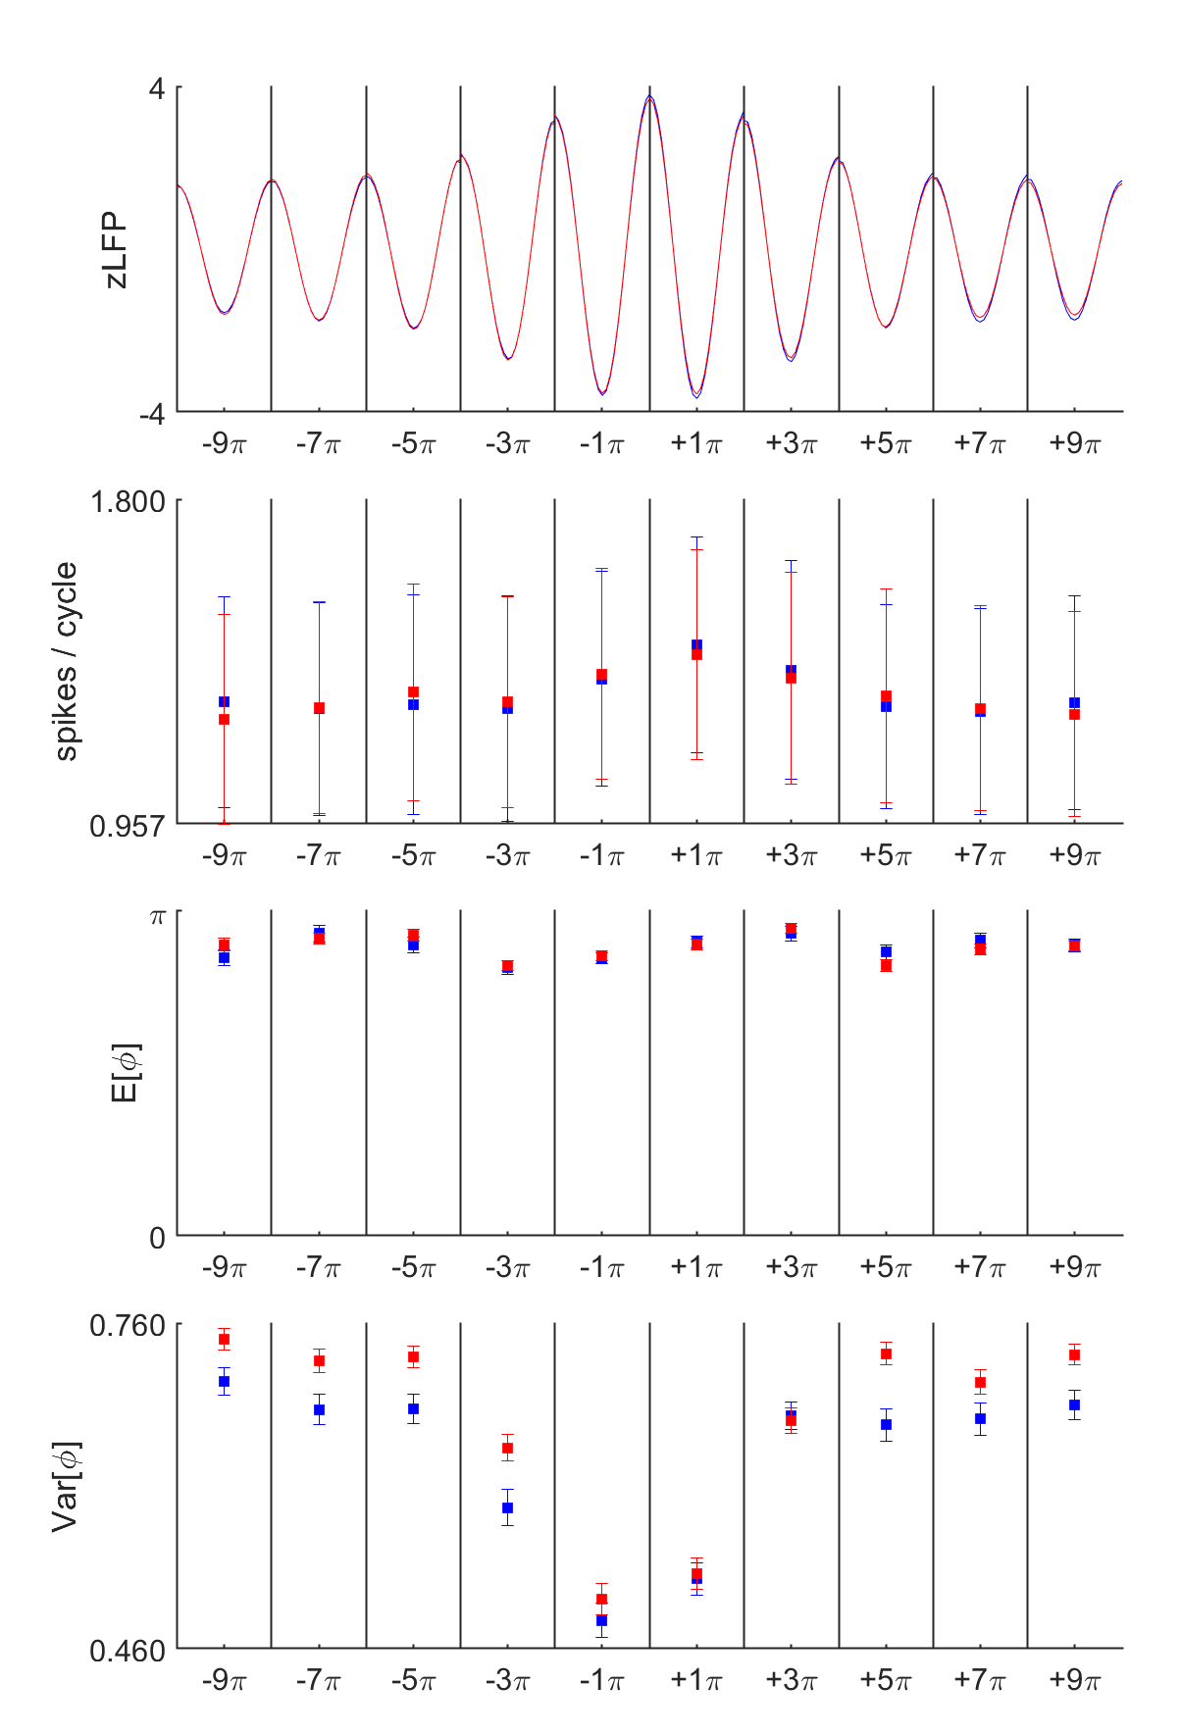
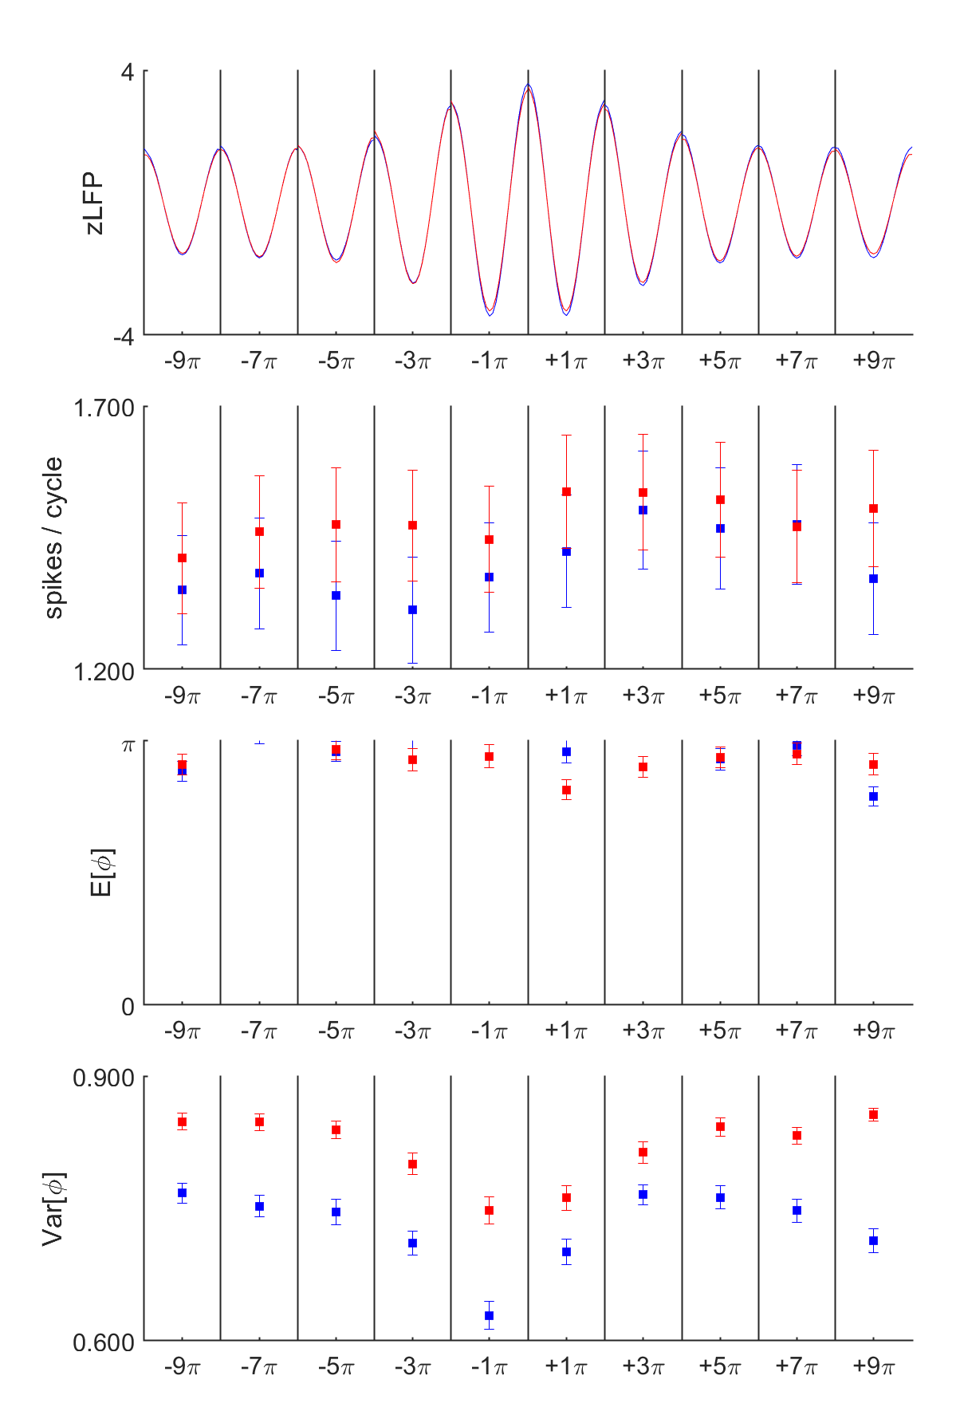
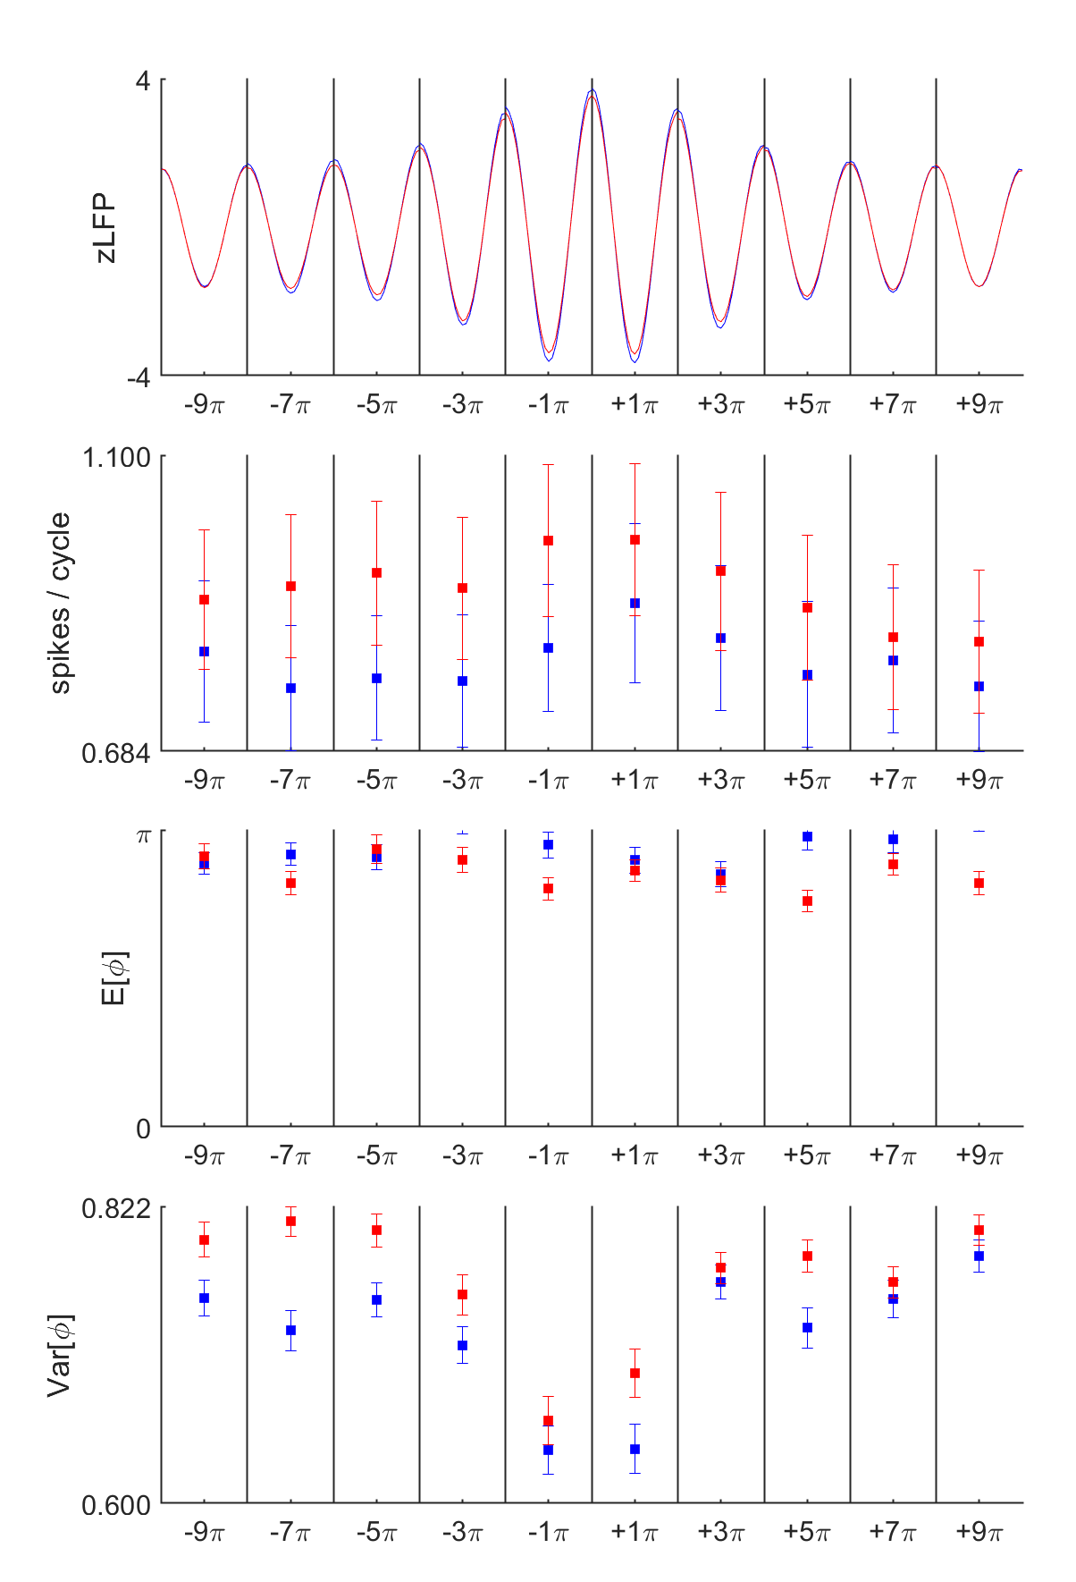
1-1. Pi - Post-sleep - nested vs. unnested
OPTO_UP
OPTO_DOWN
OPTO_OFF
Notes:
spindle_all_units_binned2pi_v2_UP2
cycle_pairwise_pairs_stats_UP_Post21_10_14Hz_21
cycle_pairwise_pairs_stats_UP_Post21_10_14Hz_22
cycle_pairwise_pairs_stats_UP_Post21_2_10_14Hz_21
cycle_pairwise_pairs_stats_UP_Post21_2_10_14Hz_22

Slide 3
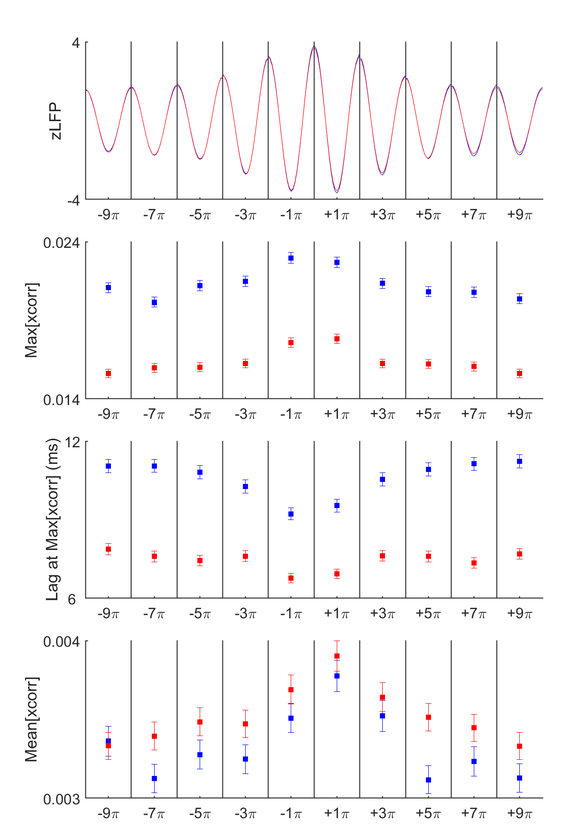
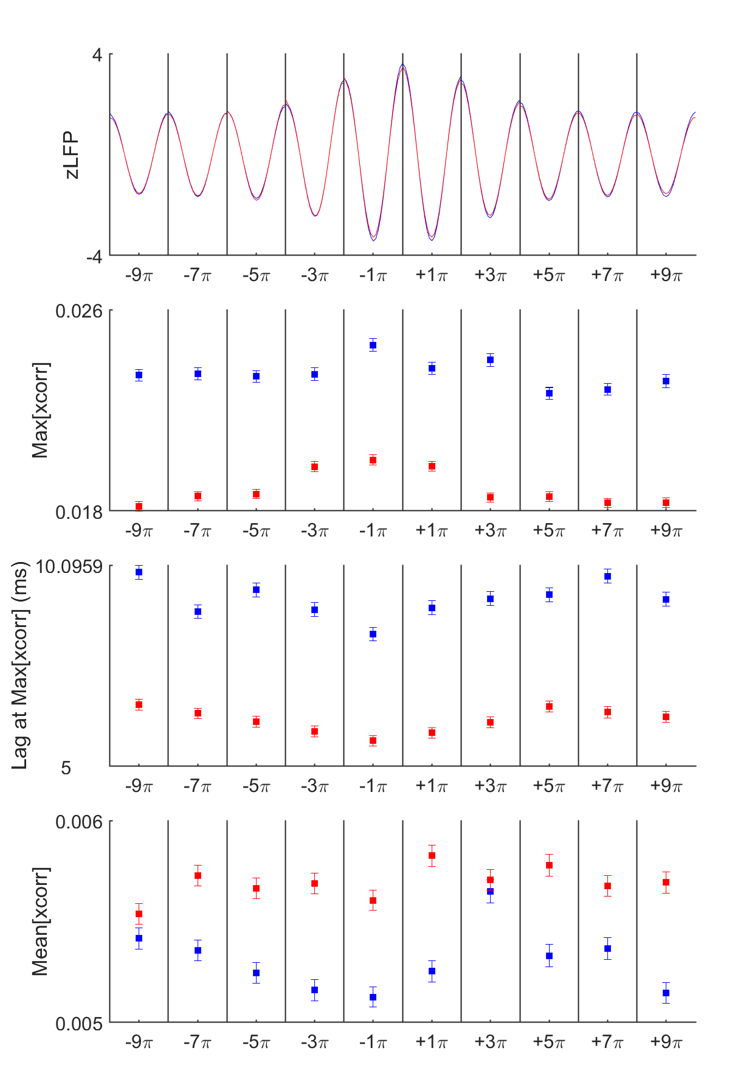
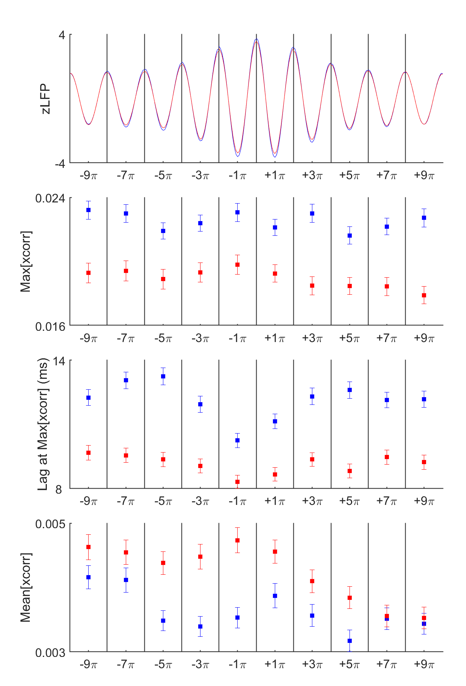
1-2. Xcorr - Post-sleep - nested vs. unnested
OPTO_UP
OPTO_DOWN
OPTO_OFF

Slide 4
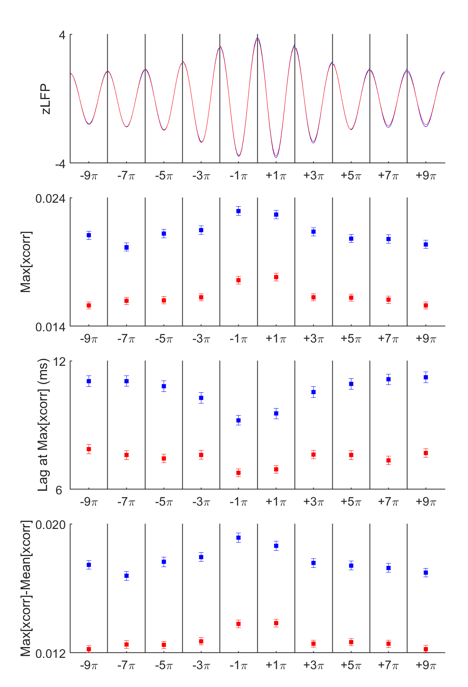
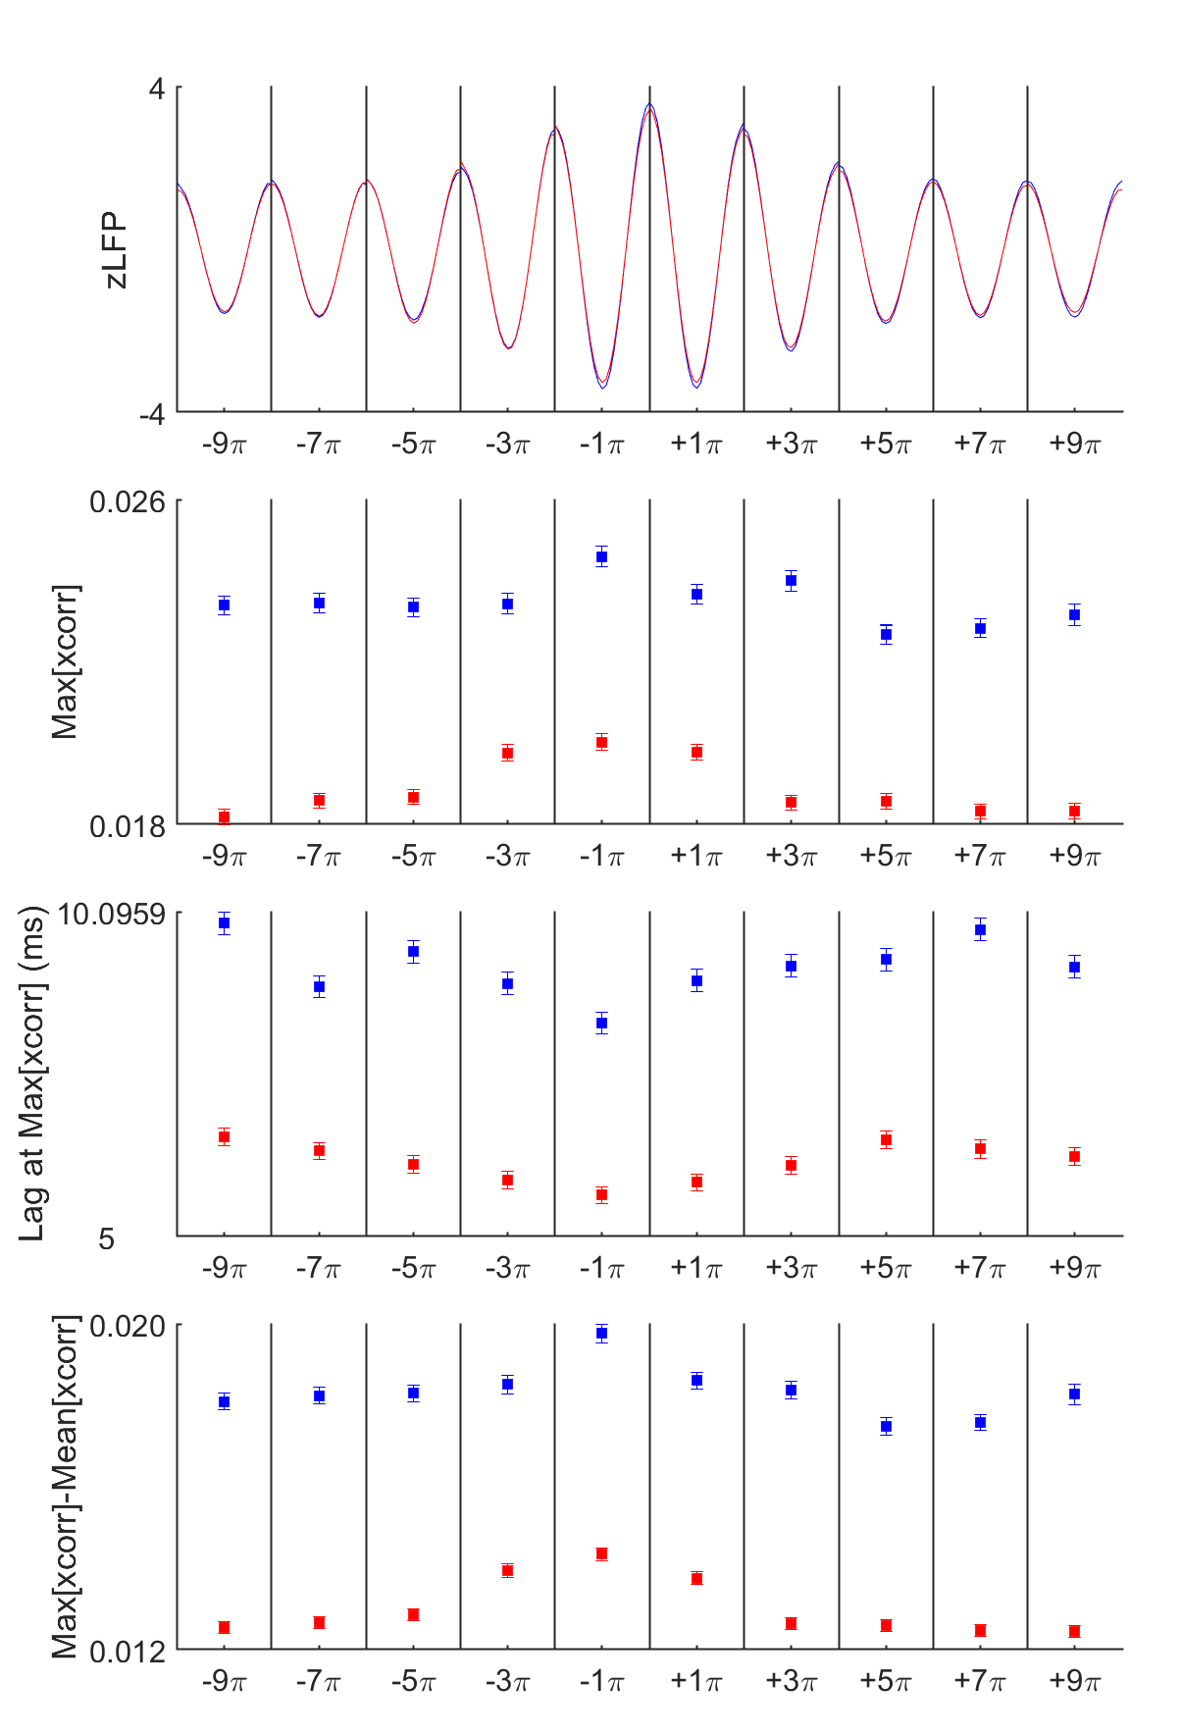
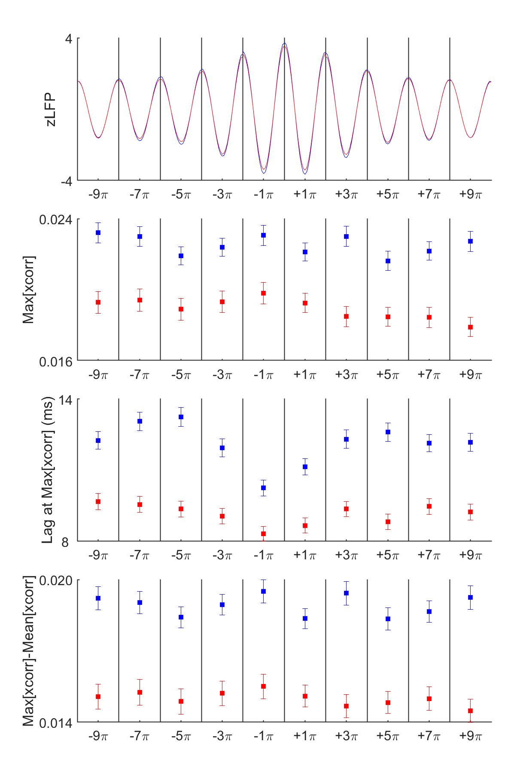
1-3. Xcorr (M-m) - Post-sleep - nested vs. unnested
OPTO_UP
OPTO_DOWN
OPTO_OFF

Slide 5
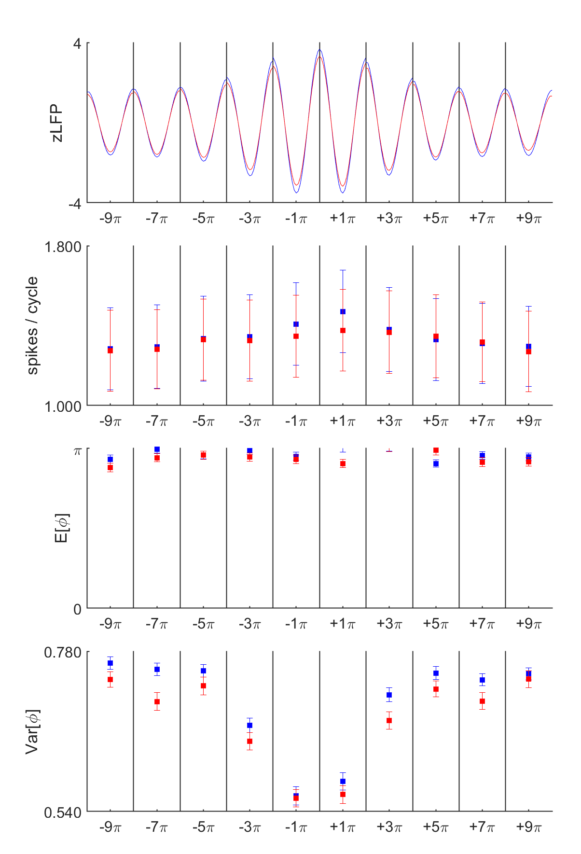
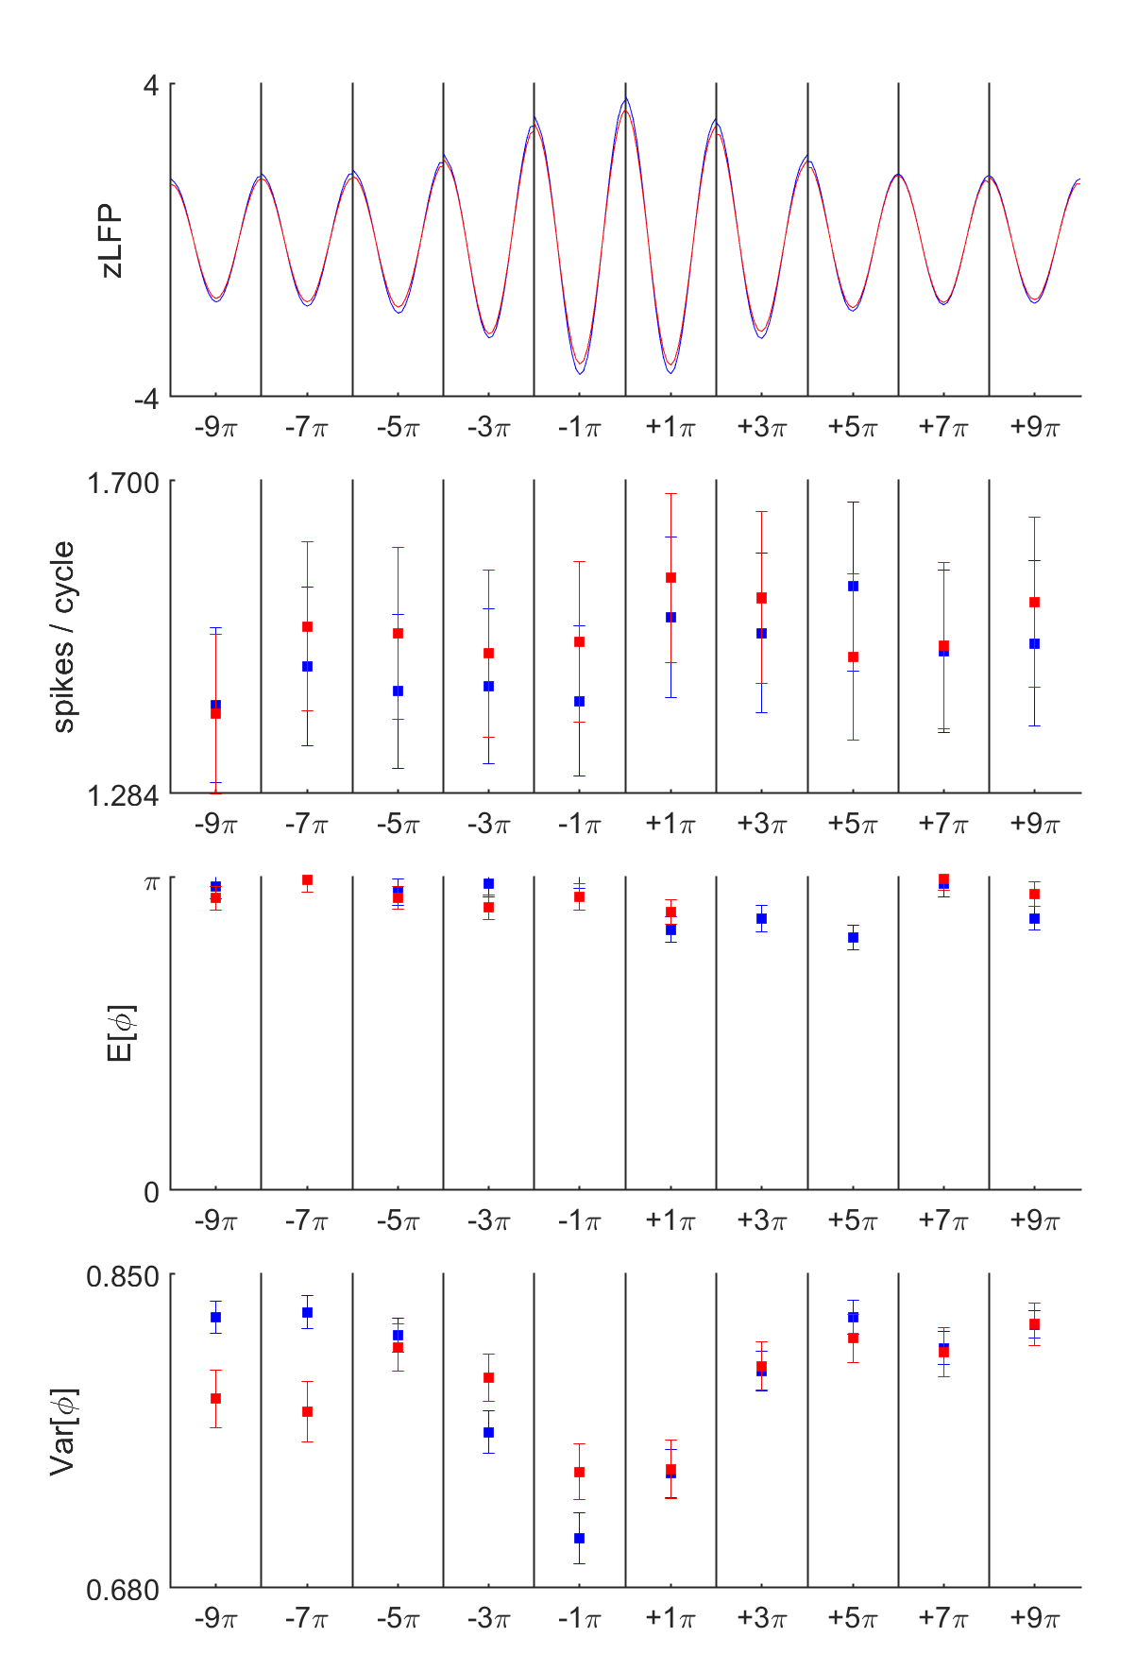
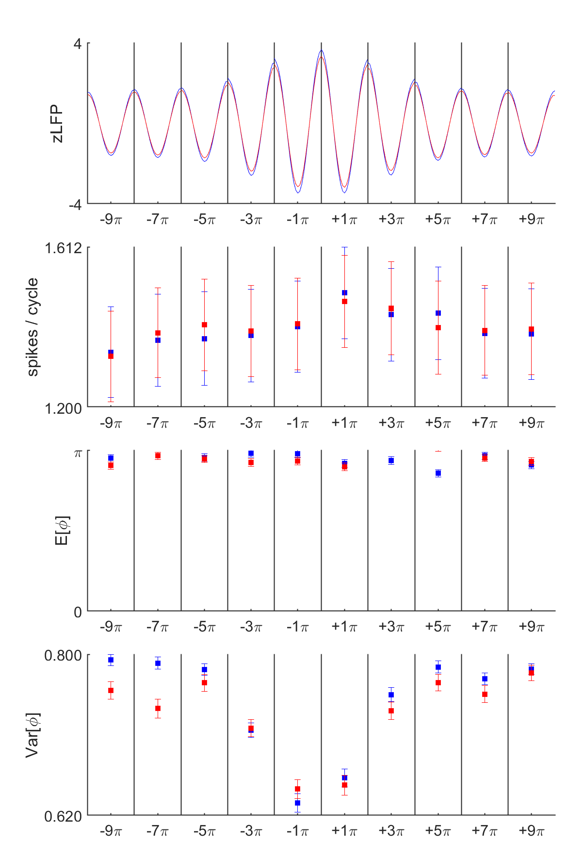
2-1. Pi - Post-sleep - spindles+OPTO_ON vs. spindles+OPTO_OFF
OPTO_UP
OPTO_DOWN
OPTO_UP+OPTO_DOWN
Notes:
Bin size kern=0.00025
spindle_all_units_binned2pi_v2_UP31
cycle_pairwise_pairs_stats_UP31_10_14Hz_21
cycle_pairwise_pairs_stats_UP31_10_14Hz_22
cycle_pairwise_pairs_stats_UP31_2_10_14Hz_21
cycle_pairwise_pairs_stats_UP31_2_10_14Hz_22

Slide 6
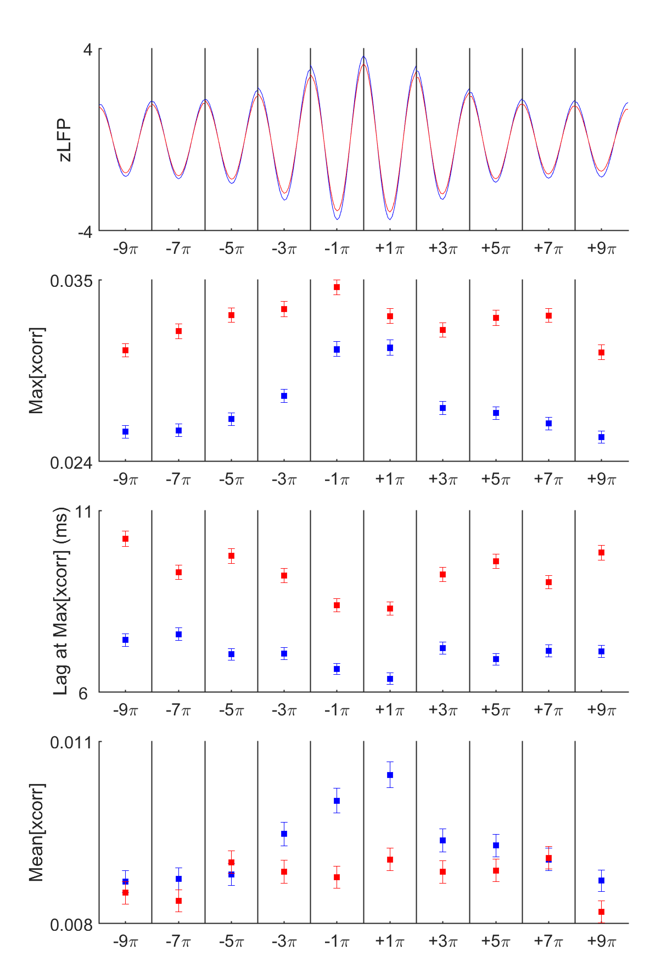
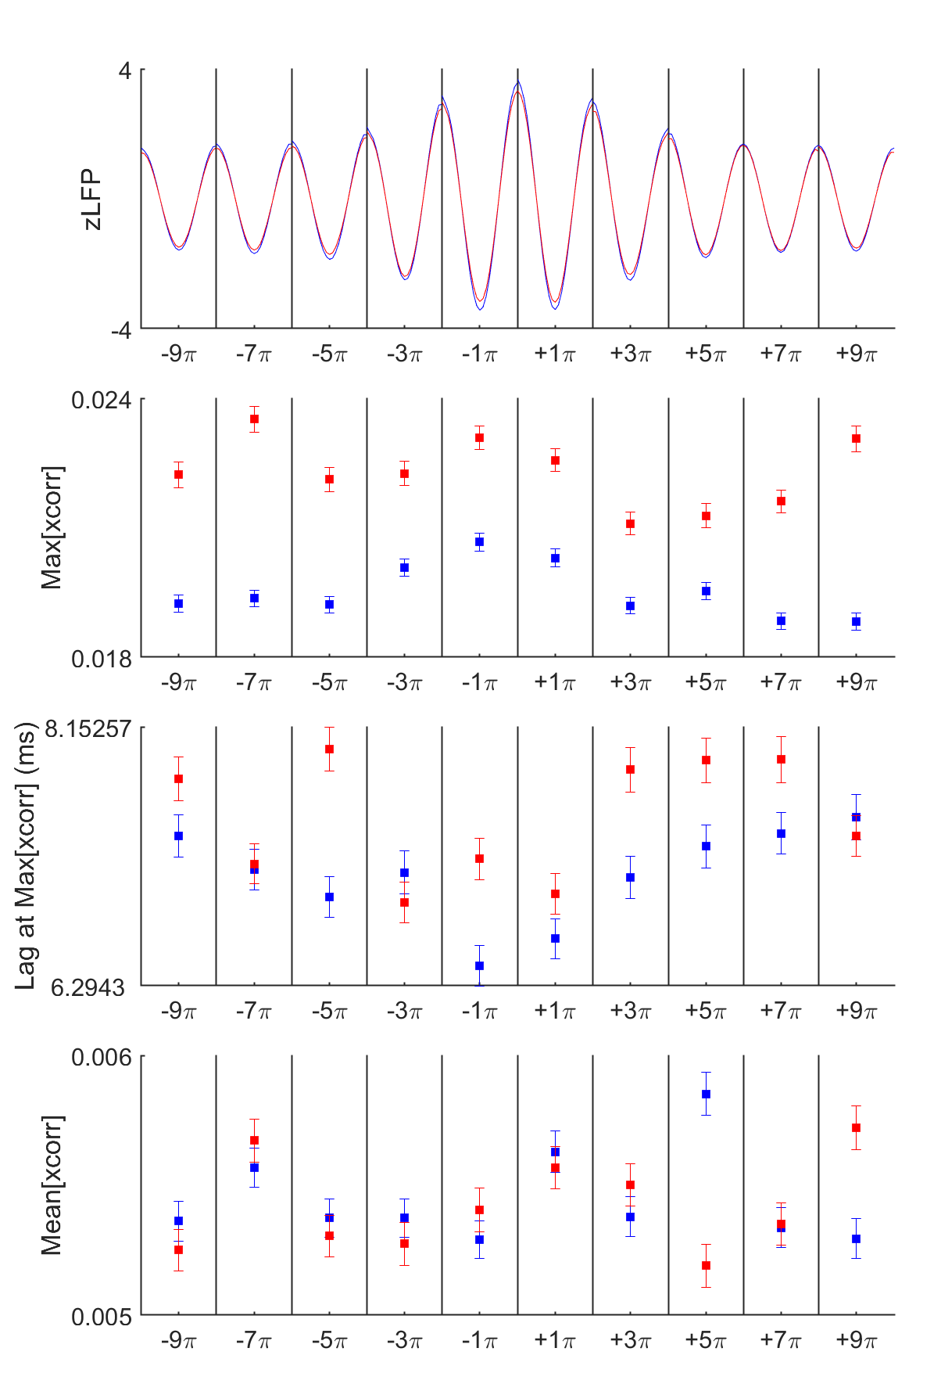
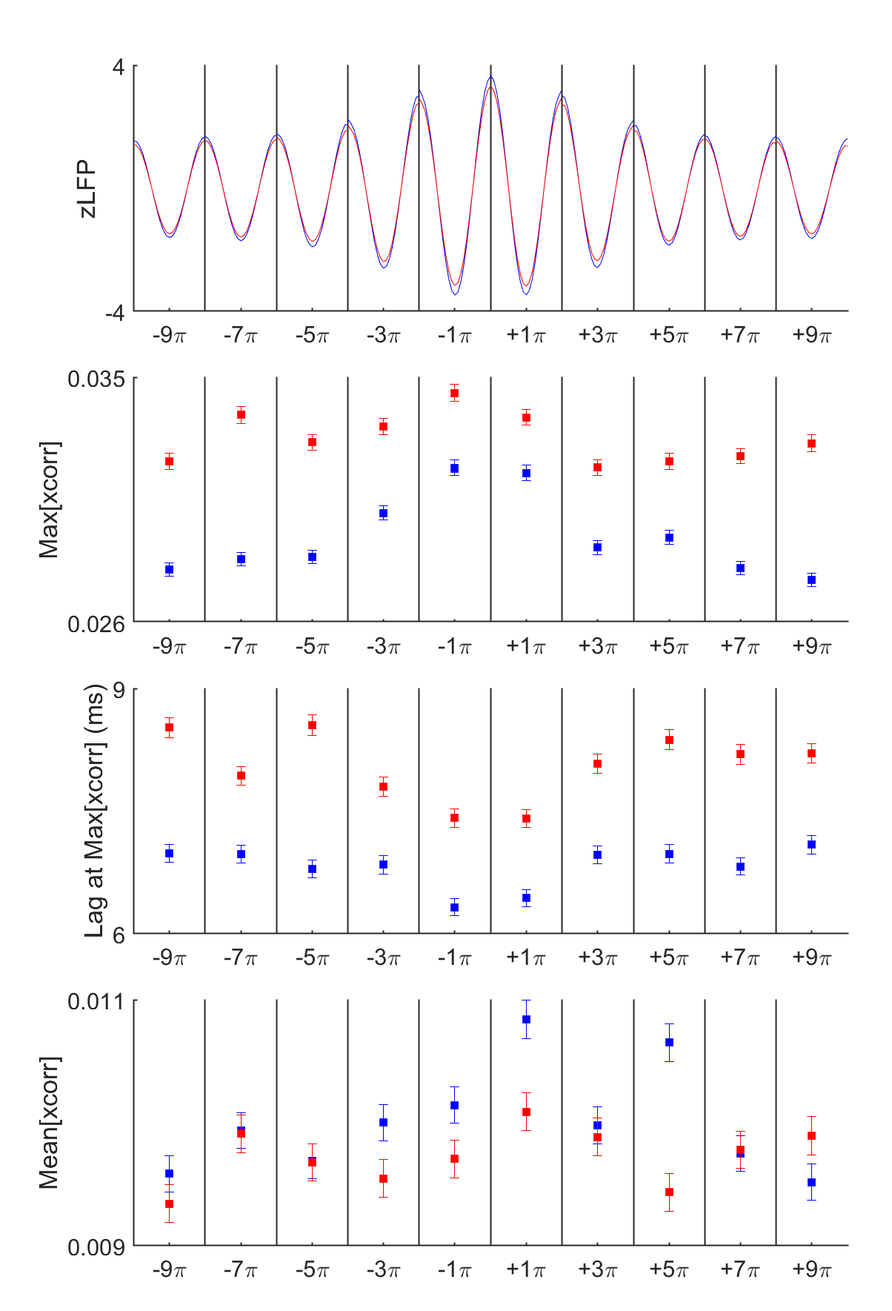
2-2. Xcorr - Post-sleep - spindles+OPTO_ON vs. spindles+OPTO_OFF
OPTO_UP
OPTO_DOWN
OPTO_UP+OPTO_DOWN

Slide 7
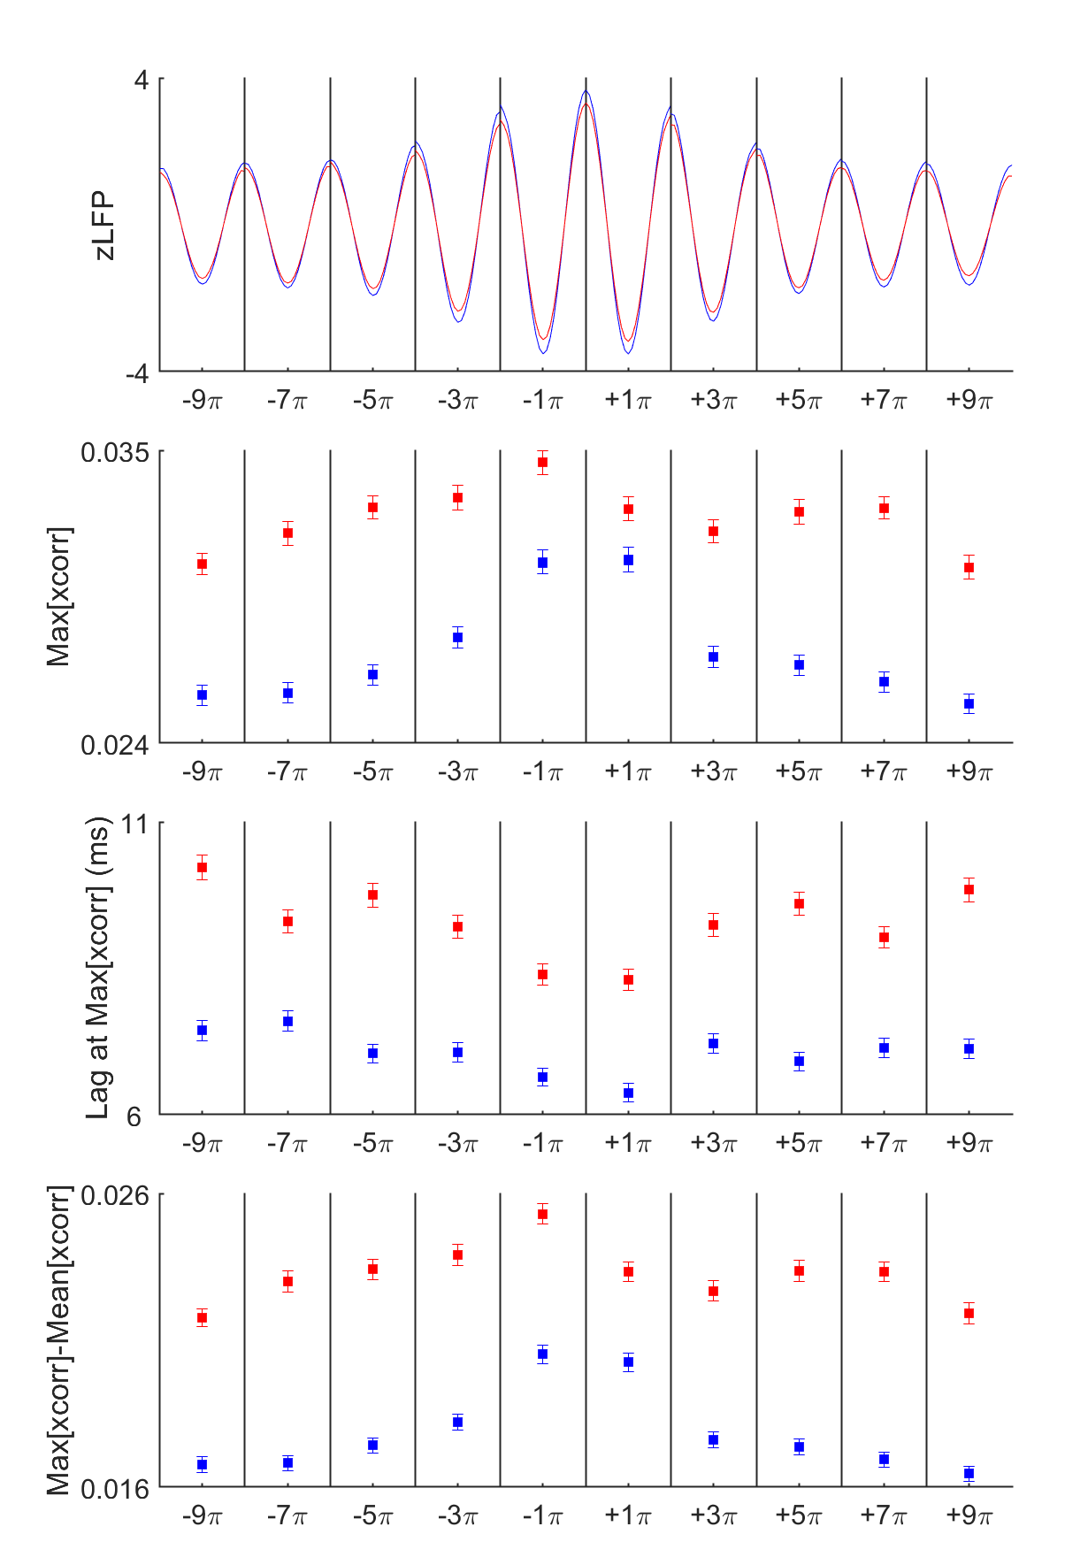
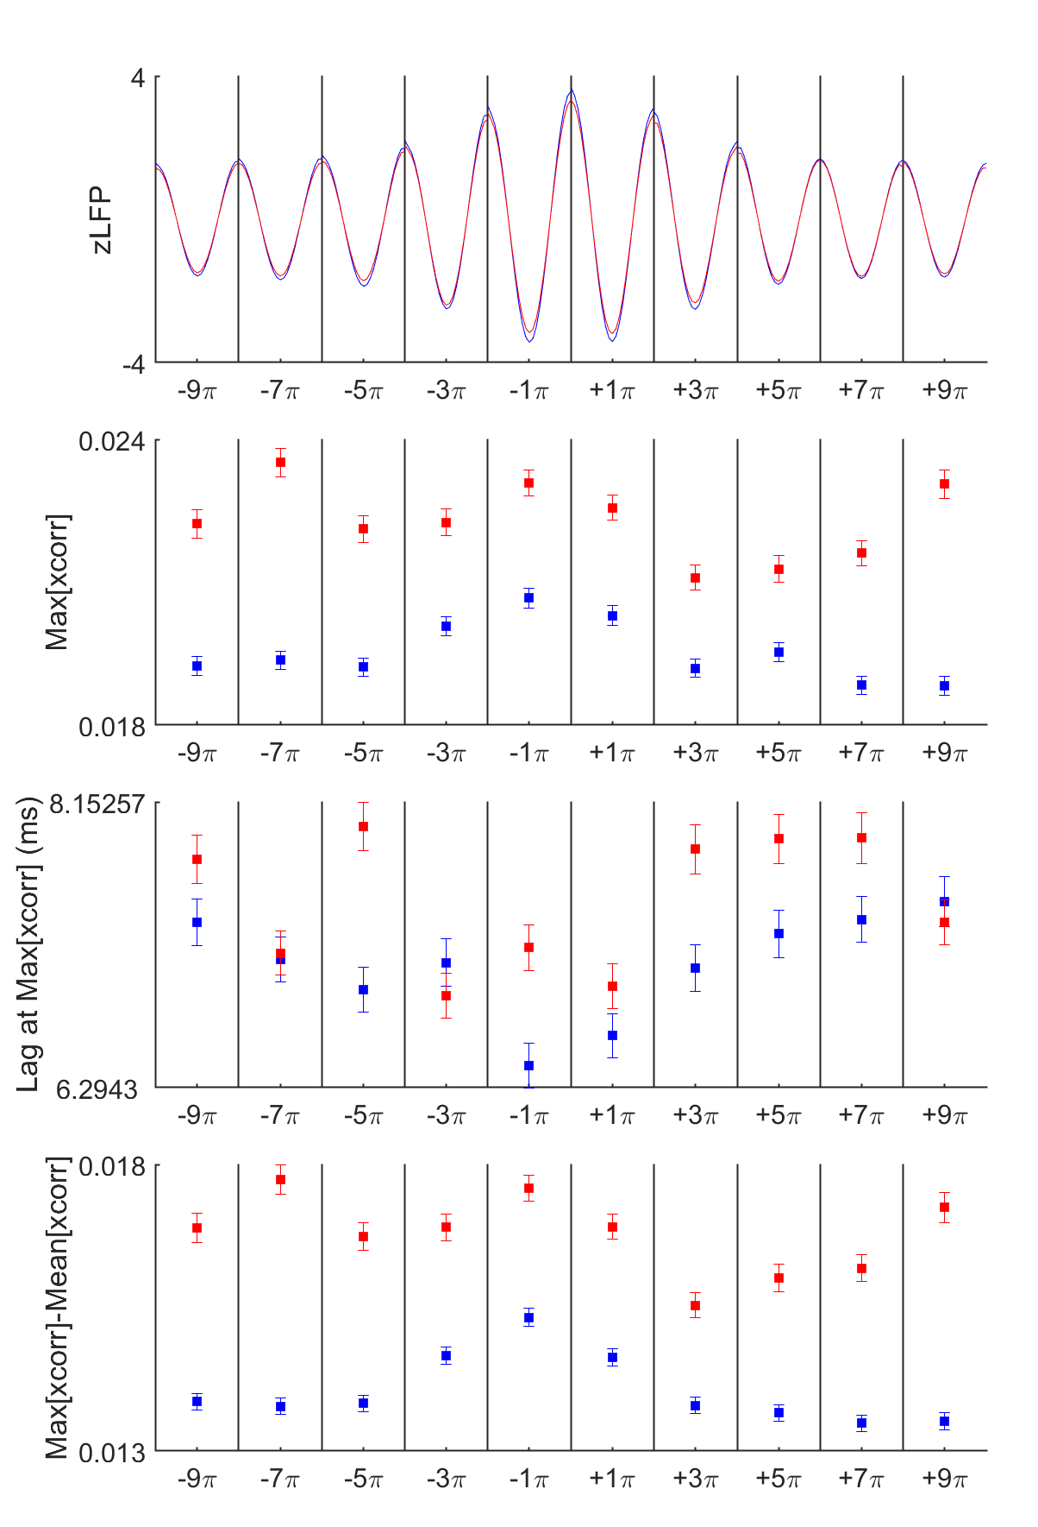
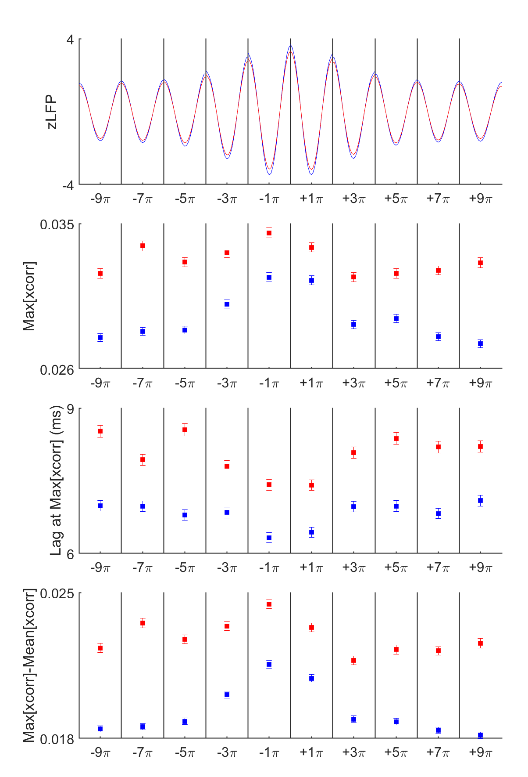
2-3. Xcorr (M-m) - Post-sleep - spindles+OPTO_ON vs. spindles+OPTO_OFF
OPTO_UP
OPTO_DOWN
OPTO_UP+OPTO_DOWN
Notes:
When reactivation occurs – how spindle works (modulates spiking activities) during that period

